Slide 1





Customer Demographics & Purchase Behaviour Analysis

Slide 2



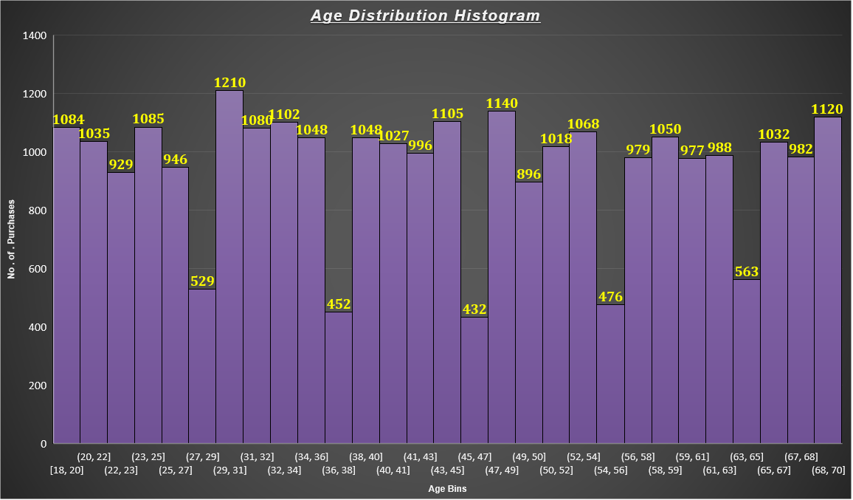
Visualization of customer age distribution
Age between 29-31 years has purchased more(i.e) 1210
As a Business Analyst , I would recommend the XYZ retail to focus more on the age group of customers between 27-29 ,36-38,45-47,54-56 and 63-65

Slide 3


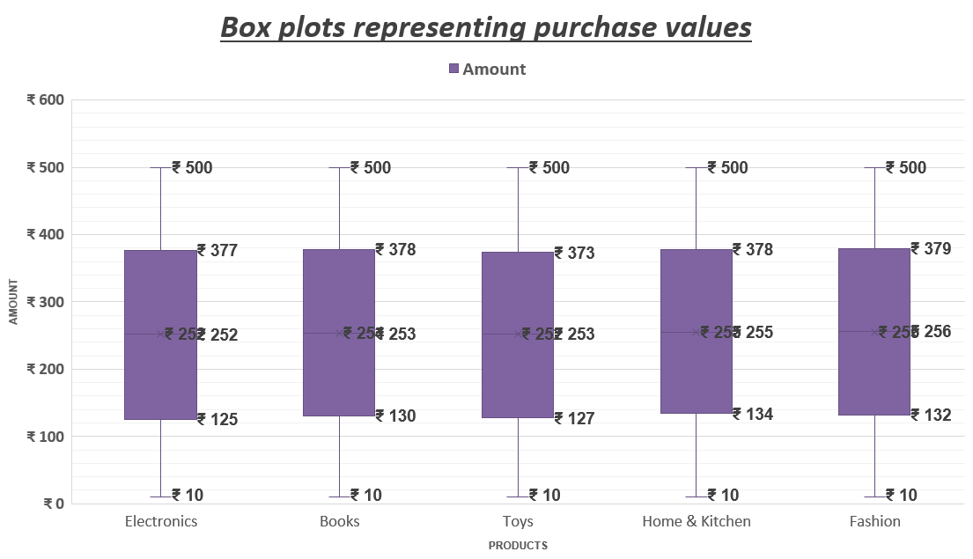
Amount Spent across Product Categories
The box plot shows that customer spending is highly consistent across all product categories, with a median purchase amount around ₹253–₹256.
All categories have a similar range of values, from ₹10 to ₹500 . The minimum and maximum purchase values are consistent .

Slide 4



Pie chart for Customer Distribution
The pie chart representing the customer distribution in terms of percentage(%) as well as in count(numbers) . However, most likely all the regions having similar number no of customer inflows .
The Highest region of customer inflow is North (26%)
y

Slide 5

Visualizing data for Product revenue contribution
The Donut chart shows that Home & Kitchen contributes the highest total revenue whereas toys contributes the Lowest Total revenue
Almost Each product category lies on the 20% itself

Slide 6

Analyzing total revenue by region , segmented by gender
By understanding from the Stacked bar chart it is visibly showing that North region had the most sales .
And , when it comes to Gender analysis from the given chart Other had the maximum Sales

Slide 7

Visualizing data proportionally
East and north shows strongest contributions especially 44-70 years
East & south are dominant in older age groups whereas North and west shows active in middle age or young age groups

Slide 8
Analyzing monthly revenue trends by product categories
The plot reveals that monthly revenue is consistent, with a peak around October.
Months like January ,March, June, and October show higher spending patterns across all categories.
.

Slide 9

Exploring relationship between Age & purchase amount
Majority of customers falls on the age group between 57-70 years
How ever there is a decent flow of customers between 18-43 years
As a Business Analyst , I would highly recommend the XYZ retail to work / cover more products between the age 44-55 . They are not an active customers when compared with others in the given analysis
.

Slide 10
Purchase across product categories
Bar chart is very simple and understandable chat , which clearly states that Home & Kitchen is in the Top place Rs.14,21,337 .
when compared to Toys , Other three products has the decent purchase inflows
It is very very Important for XYZ retail to look into product(Toys) and make effective sales accordingly

Slide 11
Visualizing purchase amount vary with customer age
It is very vague to analyze this Chart . But I hereby conclude that Customer purchasing count was more on the age above 60
Ages like 36, 50, and 55 show sudden drops in spending possibly low-volume customers.

Slide 12
Purchase trends made in each month
Line plot showing that October showing the peak sales
Lowest shopping activity occurred on December
Whereas January , June and May has the good performing period by the customers

Slide 13


Key Metrics
Data Quality
Technical Execution
Visualization effectiveness
Documentation
Insights Derived

Slide 14
Thank You

